Slide 1
Asia cup
File created on: 10/6/2023 7:34:38 AM

Slide 2
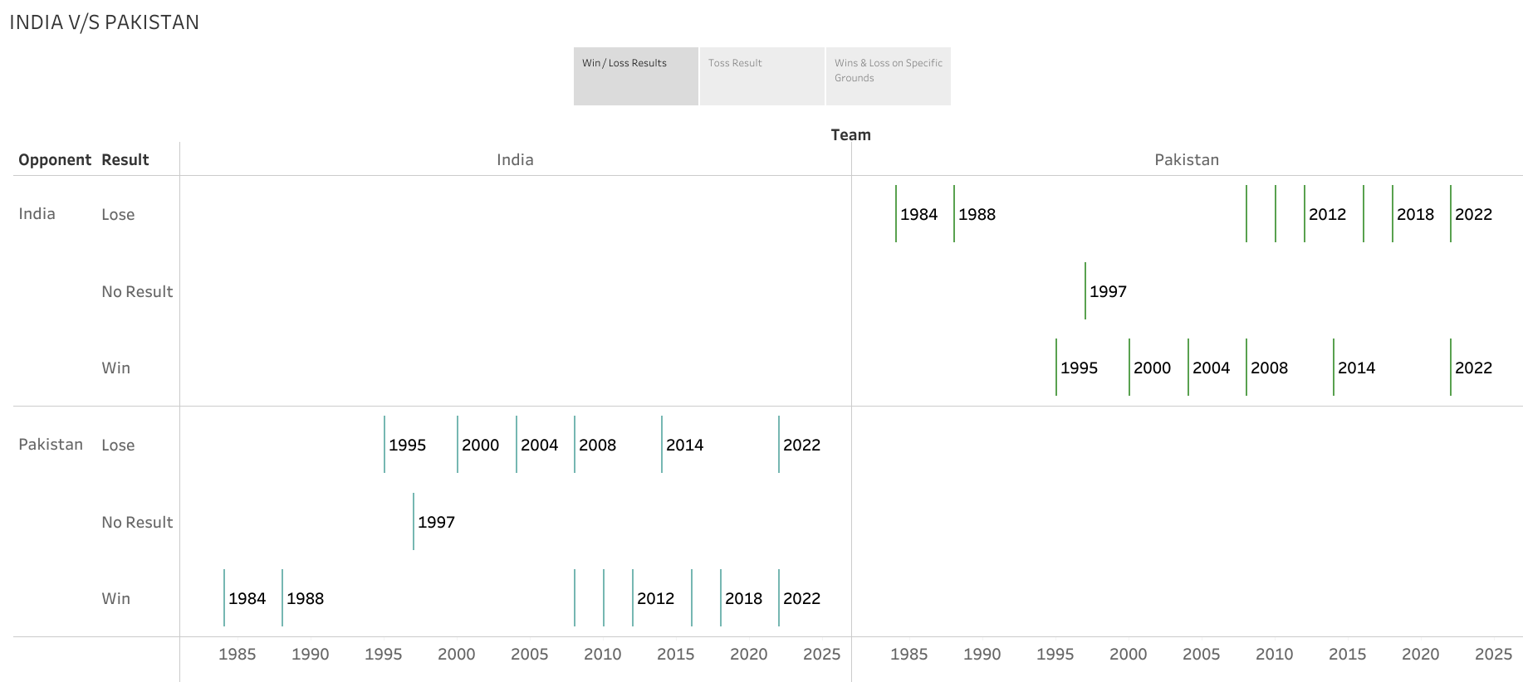

Slide 3
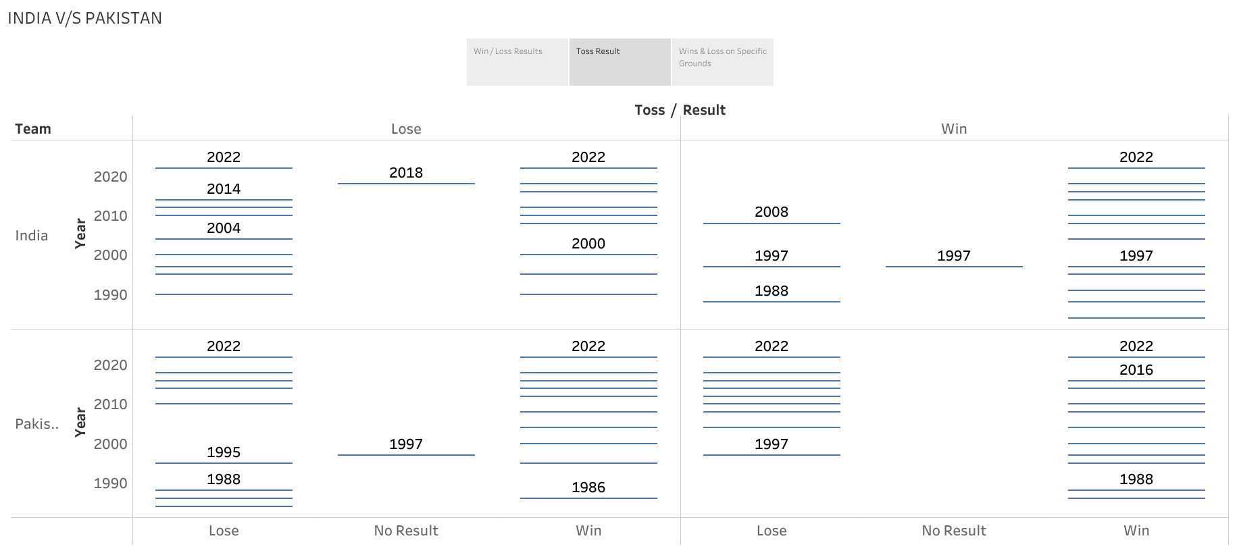

Slide 4
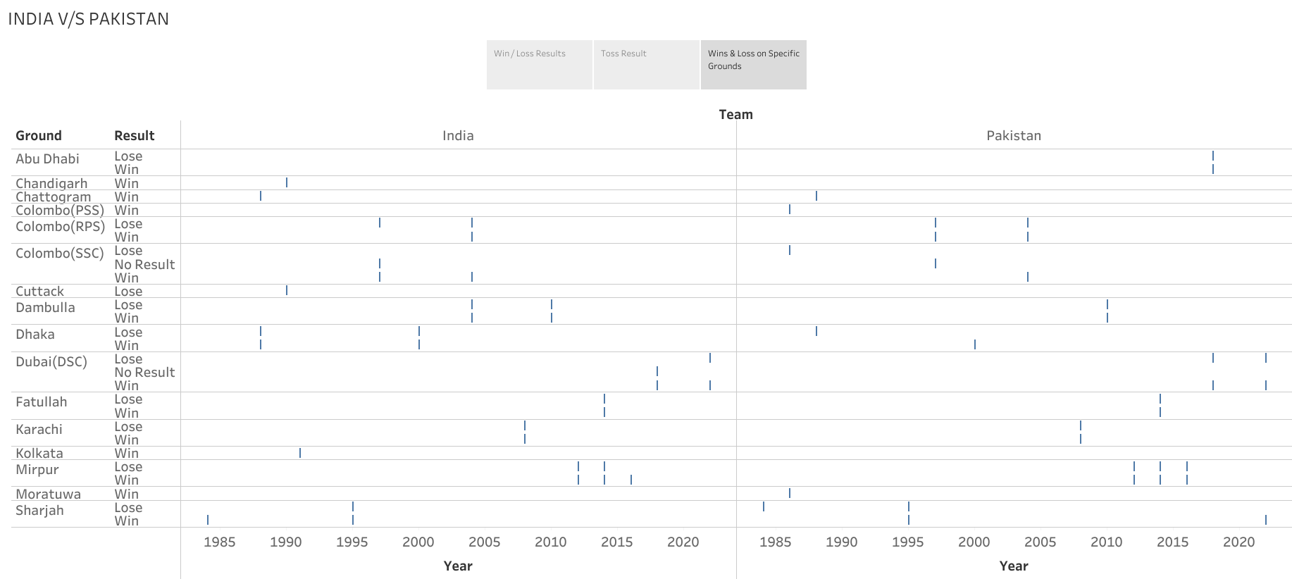

Slide 5
https://public.tableau.com/app/profile/ashfaque.shaikh6706/viz/Asiacup_16962565737540/Story2?publish=yes

